Slide 1

INTRO TO
PYTHON
Section Five

Slide 2

Python Functions
A function is a block of code which only runs when it is called.
You can pass data, known as parameters, into a function.
A function can return data as a result.

Slide 3
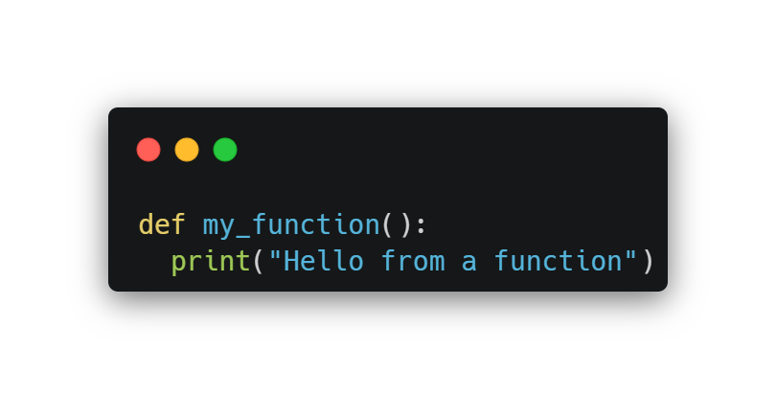
Creating a Function
In Python a function is defined using the def keyword:

Slide 4
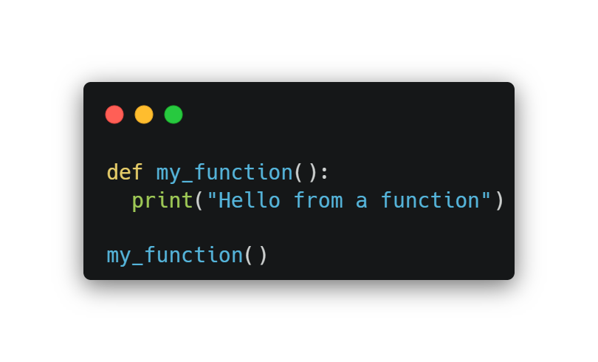
Calling a Function
To call a function, use the function name followed by parenthesis:

Slide 5
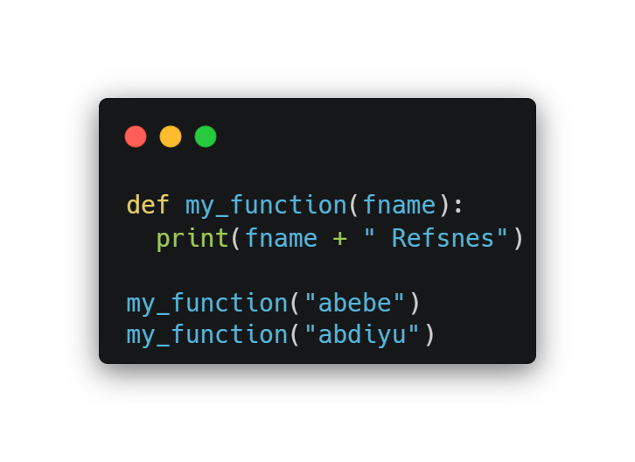
Arguments /args
Information can be passed into functions as arguments.
Arguments are specified after the function name, inside the parentheses. You can add as many arguments as you want, just separate them with a comma.

Slide 6
Parameters or Arguments?
The terms parameter and argument can be used for the same thing: information that are passed into a function.
From a function's perspective: A parameter is the variable listed inside the parentheses in the function definition.
An argument is the value that is sent to the function when it is called.

Slide 7
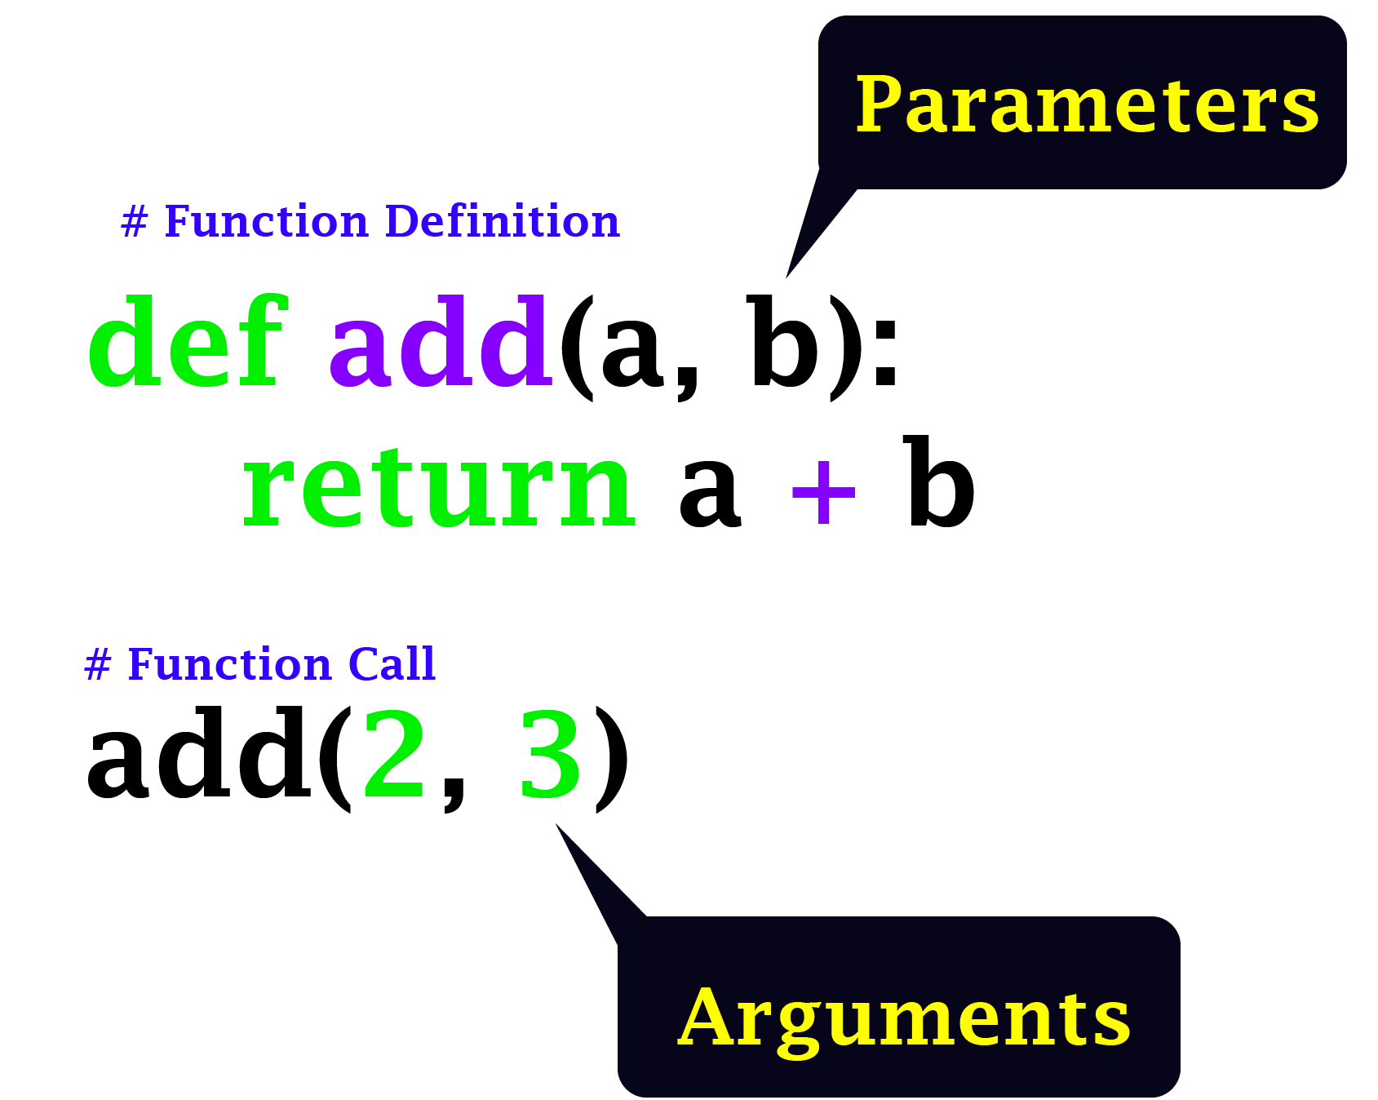

Slide 8

Number of Arguments
By default, a function must be called with the correct number of arguments. Meaning that if your function expects 2 arguments, you have to call the function with 2 arguments, not more, and not less.

Slide 9
Example
def my_function(fname, lname):
print(fname + " " + lname)
my_function("Emil", "Refsnes")

Slide 10
Arbitrary Arguments, *args
If you do not know how many arguments that will be passed into your function, add a * before the parameter name in the function definition.
This way the function will receive a tuple of arguments, and can access the items accordingly:

Slide 11
Example
If the number of arguments is unknown, add a * before the parameter name:
def my_function(*kids):
print("The youngest child is " + kids[2])
my_function(“abebe", “kebede", “dani")

Slide 12
Keyword Arguments /kwargs/
You can also send arguments with the key = value syntax. This way the order of the arguments does not matter.
Example
def my_function(child3, child2, child1):
print("The youngest child is " + child3)
my_function(child1 = "Emil", child2 = "Tobias", child3 = "Linus")

Slide 13
Arbitrary Keyword Args, **kwargs
f you do not know how many keyword arguments that will be passed into your function, add two asterisk: ** before the parameter name in the function definition.
This way the function will receive a dictionary of arguments, and can access the items accordingly
def my_function(**kid):
print("His last name is " + kid["lname"])
my_function(fname = "Tobias", lname = "Refsnes")

Slide 14
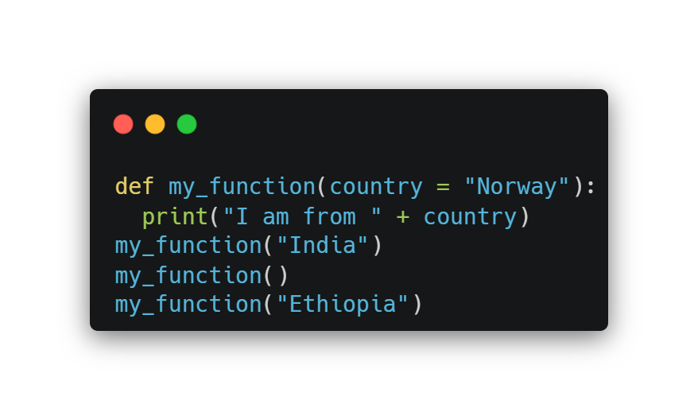
Default Parameter Value
The following example shows how to use a default parameter value. If we call the function without argument, it uses the default value:

Slide 15
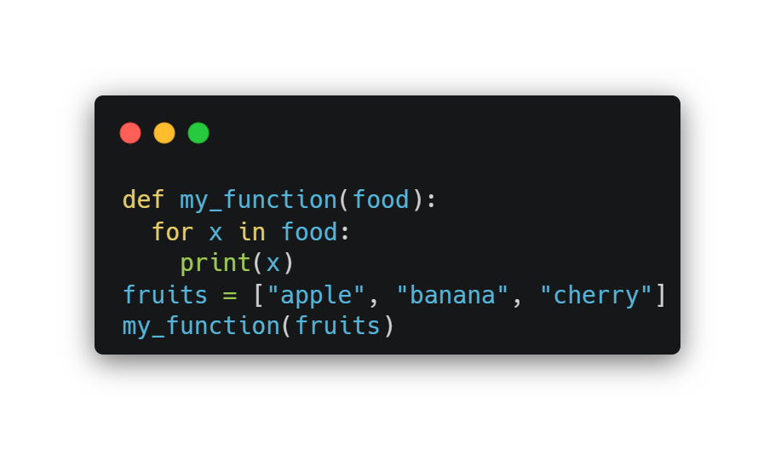
Passing a List as an Argument
You can send any data types of argument to a function (string, number, list, dictionary etc.), and it will be treated as the same data type inside the function.
E.g. if you send a List as an argument, it will still be a List when it reaches the function:

Slide 16
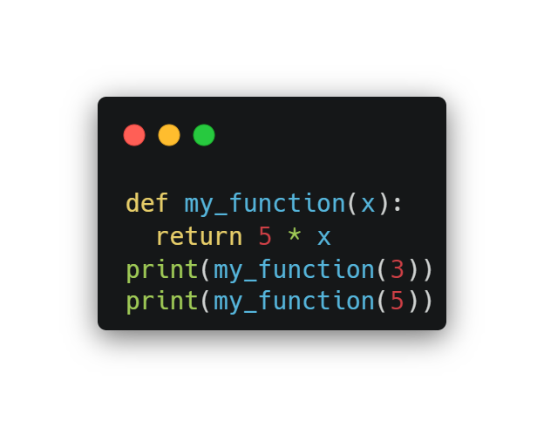
Return Values
To let a function return a value, use the return statement:

Slide 17
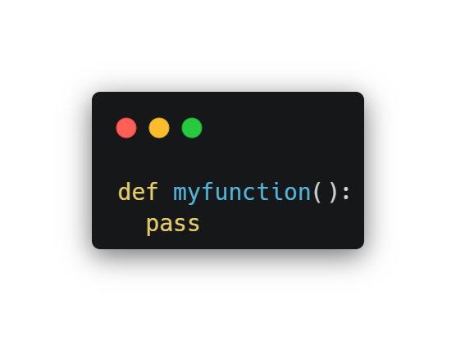
The pass Statement
function definitions cannot be empty, but if you for some reason have a function definition with no content, put in the pass statement to avoid getting an error.

Slide 18
Recursion
Recursion is a common mathematical and programming concept. It means that a function calls itself. This has the benefit of meaning that you can loop through data to reach a result.
The developer should be very careful with recursion as it can be quite easy to slip into writing a function which never terminates, or one that uses excess amounts of memory or processor power. However, when written correctly recursion can be a very efficient and mathematically-elegant approach to programming.

Slide 19
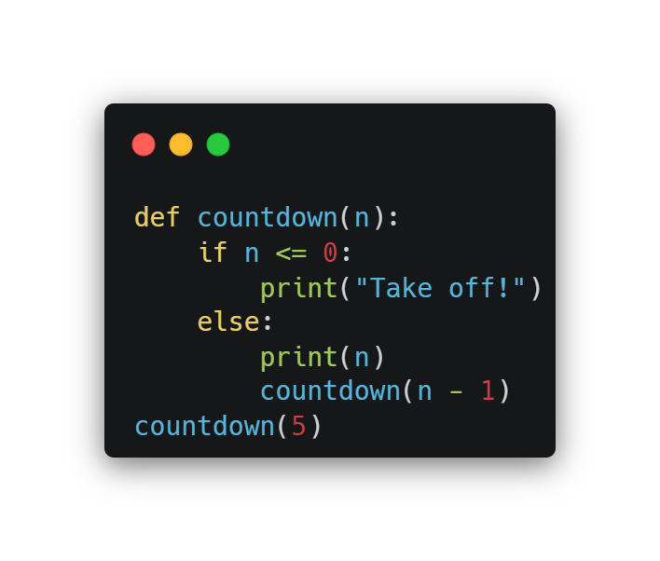
Example

Slide 20

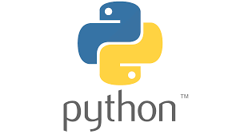
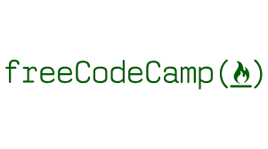


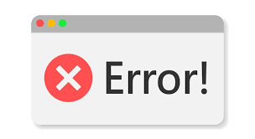
Free Resources To Advance

Slide 21


